Slide 1
Analysis of Catalogue of Life Usage & Users
WP2 team at BGCI

Slide 2
What we knew about users at the start
Web - 30-40,000 serious users per month
GBIF, EOL (others) & about 40 national biodiversity portals
CD-Rom – 3500 copies distributed each year
Web analysis
  Server logs processed by Awstats system
  Page tagging with Google Analytics (implemented November 2009)
    Google Analytics provides marketing focus

Slide 3
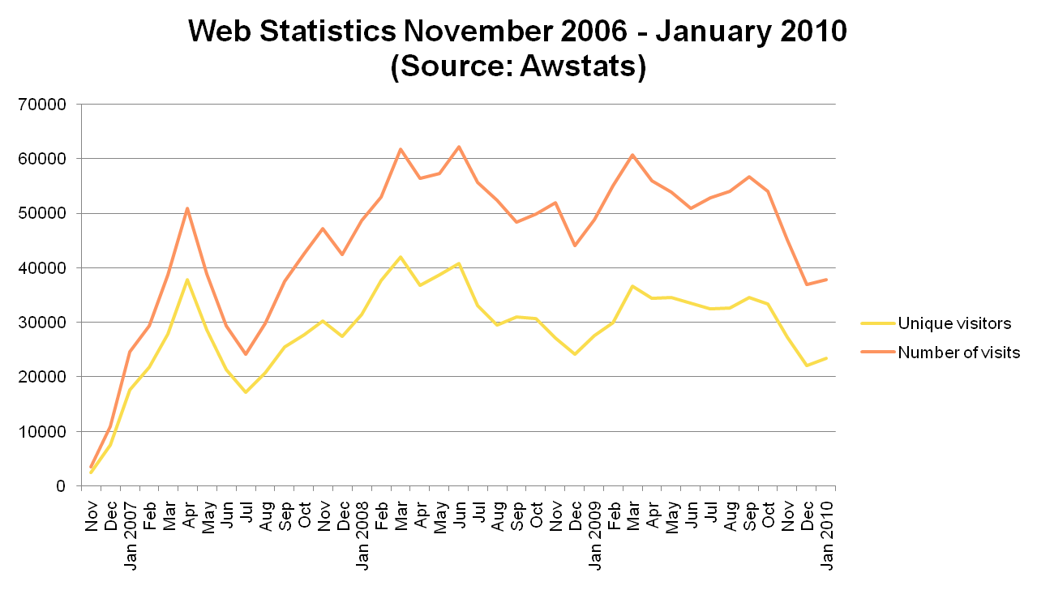
Web Analysis: Monthly totals

Slide 4
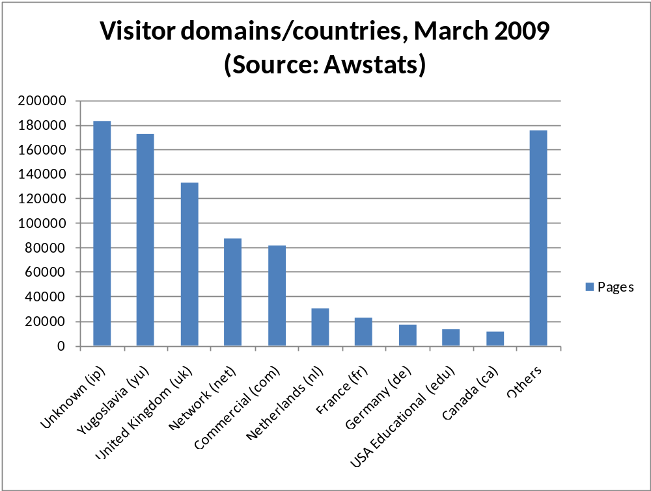
Country at peak usage 2009

Slide 5
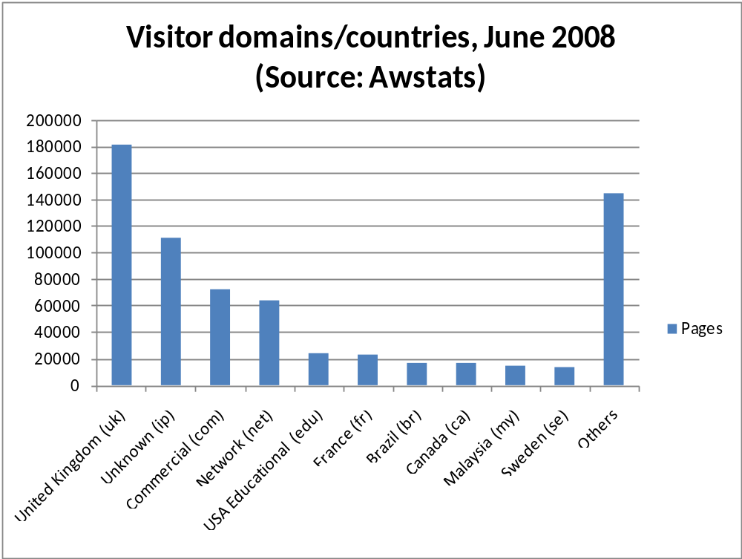
Country at peak usage 2008

Slide 6
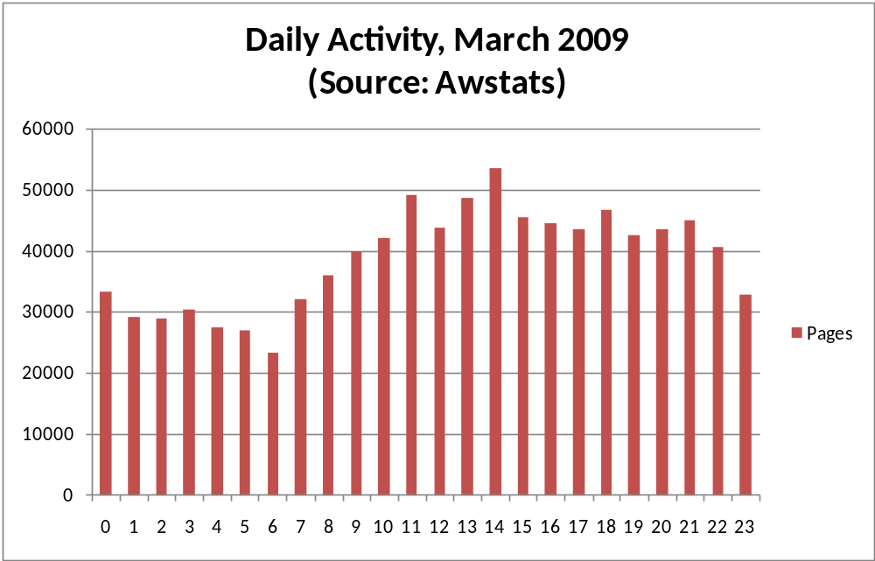
Daily Activity at peak usage 2009

Slide 7
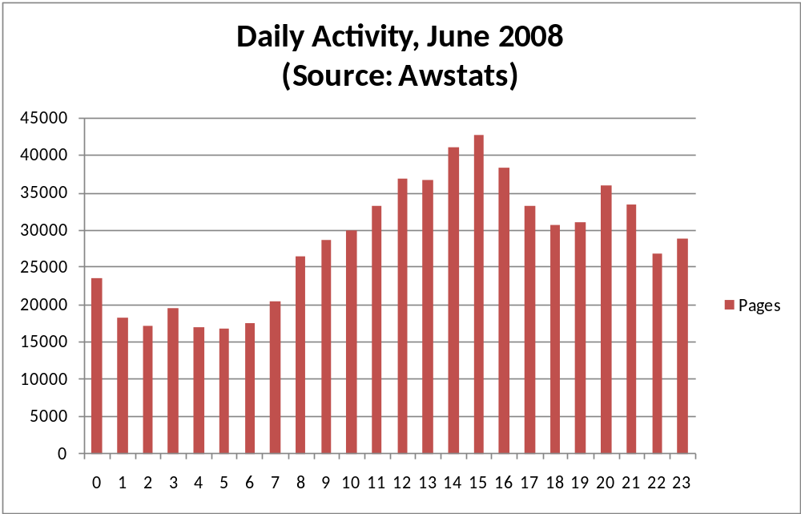
Daily Activity at peak usage 2008

Slide 8
Users requesting Annual CD
User type | 2006 | 2007 | 2008
Individuals | 71 | 72 | 88
Museums | 7 | 5 | 8
Universities and schools | 19 | 20 | 36
Students | 3 | 6 | 10
Government Departments | 3 | 5 | 9
NGOs | 3 | 1 | 6
Commercial | 6 | 6 | 10
Others | 14 | 4 | 7
Total | 126 | 119 | 174
  Excluding CoL partner organisations

Slide 9
User Classification
  Major global biodiversity portals and organization
  National portals and programmes, NGOs and higher education institutes
  Particular subsets of the 40,000 individual users
  Commercial organisations that do or may use CoL

Slide 10
Proposed user classes
User class | Description
Integrator | Takes data from Annual Checklist CD-Rom and incorporates it into their own information system, e.g. GBIF and EoL. This might be the entire catalogue or sections of it, such as a family or genus. Are there instructions on how this could be done?
Linker | Use their own classification, e.g. NCBI and IUCN, and include links to relevant sources of information, i.e. CoL for taxonomic details.
Hub | Use the CoL website as the starting point for finding information about a species, such as pictures, species description, conservation status, literature, etc. Potential overlap with EoL and also Tree of Life.
Checker | Use the CoL website to check taxonomic details, for example correct spelling, its accepted name, synonyms and common names.
Taxonomist | Use the CoL website to view the preferred classification with competing ones.

Slide 11
Proposed user classes (contd)
User class | Description
Biodiversity | Ask biodiversity questions, such as: where are the most species; where are the most endemic species; and where are endangered species.

Slide 12
Methodology: Questionnaire
Questionnaire to find out about users and their priorities
  Published on BGCI website (20 October 2009)
  Published on 4D4Life website (22 October 2009)
  GPCC members (c. 40, 27 October 2009)
  Bionet regional partnerships (LOOPs) (27, October)
  Promoted via Taxacom (c. 1,700) & Conbio mailing lists (23 October 2009)
  Annual Checklist CD-Rom mailing list (c. 500) (27 October 2009)
  TDWG meeting (November 2009)
  Durban Education Congress (November 2009)

Slide 13
Methodology: Questionnaire (contd)
  CBD contacts (c. 300) (19 November 2009)
  Published on 6 LinkedIn commercial related forums (c. 77,000) (19 November 2009)
  Mailout to companies (c. 100) (23 November 2009)
  IUCN SSC e-bulletin (c. 7,000) (November 2009)
  GBIF telephone interview (November 2009)
  Washington, D.C. visit (December 2009)
  Cambridge visit (December 2009)
  244 respondents = 202 complete + 42 incomplete

Slide 14
Methodology: Interviews
Interviews with major Biodiversity portals and organisations
  David Remsen, GBIF
  Martin Sneary, IUCN/Birdlife International
  David Schindel, Barcode of Life
  Scott Federhen, National Centre for Biotechnology Information
  Colby Loucks, WWF US
  Jim Edwards, EOL
  Craig Hilton-Taylor, IUCN

Slide 15
What we found out subsequently
Summary of responses
  Country
  Sector
  User Type
  Work Responsibilities
  Types of Species Related Information
  Frequency of Information Use
  Sets of Species Name Information
  Problems with use of scientific species names
  Other Sources of Species Information
  Preference for accessing taxonomic information

Slide 16
Responses by Country
Country | No. of responses
United States | 36
United Kingdom | 29
Portugal | 11
India | 10
Italy | 9
Canada | 8
Germany | 6
Others (53 countries) | 93
Total | 202
  Mainly UK & US but some from non-English speaking countries

Slide 17
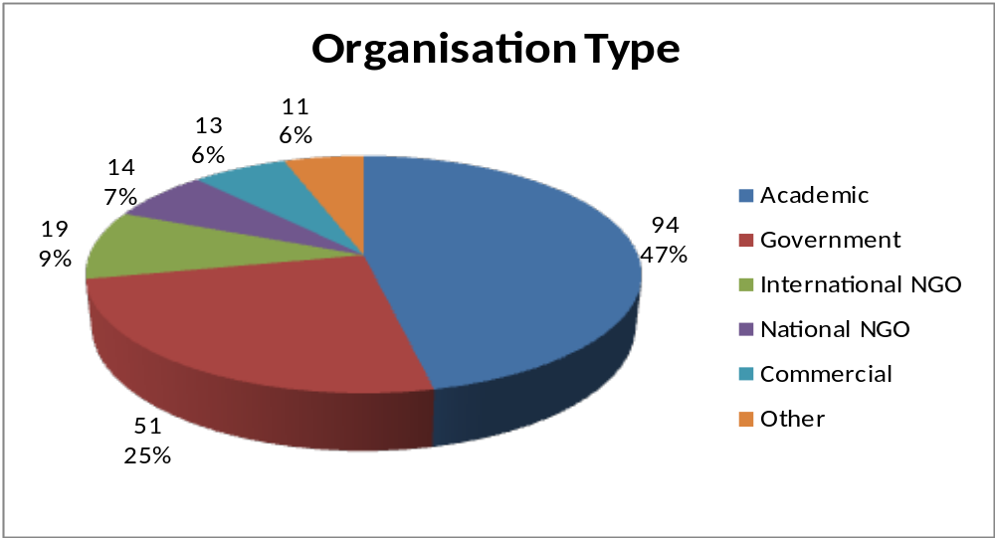
Responses by Sector (contd)

Slide 18
CoL User Type (All)
Options | No. of responses
Never heard of it | 21
Used it and likely to use it again | 113
Not used it and likely to use it | 49
Used it and unlikely to use it again | 9
Not used it and unlikely to use it | 10
Total | 202
  50% of those sampled said they were likely to use it again. Only 5% said they would not.

Slide 19
Work Responsibilities
Responsibility | No. of responses
Research | 139
Managing data and information | 88
Management | 74
Customer Services | 31
Other | 42
Total | 374

Slide 20
Types of Species Related Information
Type of species related information | No. of responses
Distribution data | 159
Biodiversity conservation | 142
Collections | 132
Placement in taxonomic hierarchies | 116
Morphological | 98
Scientific names | 87
Life cycle | 84
Uses of biodiversity | 78
Other | 30
Total | 971

Slide 21
Frequency of Information Use
Frequency | No. of responses
At least once a day | 113
At least once a week | 54
At least once a month | 27
At least once a year | 7
Never | 1
Total | 202

Slide 22
Sets of Species Name Information
Sets | No. of responses
Taxonomic groups | 162
Conservation (e.g. endangered) | 124
Geographical | 123
Ecosystem | 84
Social or cultural use | 69
Other | 14
Total | 576

Slide 23
Problems with use of scientific species names
Problem | No. of responses
Uncertainty over synonymy | 68
Lack of additional information | 47
Spelling of accepted name | 27
Tracking circumscription changes | 22
Lack of common name usage | 18
Other | 19
Total | 201

Slide 24
Other Sources of Species Information
Source of Information | No. of responses
Online information systems | 168
Published literature | 165
Species checklists | 137
Collections | 116
Species inventory programmes | 84
Grey literature | 64
Other | 26
Total | 760

Slide 25
Preference for accessing taxonomic information
Accessing Information | No. of responses
Web pages | 155
Download (for use in own systems) | 141
Hard copy | 70
Alternative computer interface | 56
Other | 9
Total | 431

Slide 26
CoL User Type (Commercial)
Options | No. of responses
Never heard of it | 0
Used it and likely to use it again | 10
Not used it and likely to use it | 2
Used it and unlikely to use it again | 0
Not used it and unlikely to use it | 1
Total | 13
  Poor response to mailout and use of LinkedIn groups

Slide 27
CoL User Type (Academic )
Options | No. of responses
Never heard of it | 7
Used it and likely to use it again | 55
Not used it and likely to use it | 25
Unlikely to use it or to use it again | 7
Total | 94

Slide 28
CoL User Type (Government )
Options | No. of responses
Never heard of it | 8
Used it and likely to use it again | 26
Not used it and likely to use it | 12
Unlikely to use it or to use it again | 5
Total | 51

Slide 29
CoL User Type (International NGO)
Options | No. of responses
Never heard of it | 1
Used it and likely to use it again | 11
Not used it and likely to use it | 3
Unlikely to use it or to use it again | 4
Total | 19

Slide 30
CoL User Type (National NGO)
Options | No. of responses
Never heard of it | 2
Used it and likely to use it again | 5
Not used it and likely to use it | 7
Unlikely to use it or to use it again | 0
Total | 14

Slide 31
Products Used
Options | Annual checklist on CD-Rom | Annual checklist on web | Dynamic checklist | Web service
Yes | 59 | 75 | 50 | 58
No | 30 | 23 | 29 | 36
Unaware it existed | 24 | 15 | 34 | 19
Total | 113 | 113 | 113 | 113

Slide 32
Why Don’t Use
Options | No. of Responses
Incomplete names | 4
Incomplete taxonomy | 5
Lack of taxonomic detail | 2
Lack of explanation | 3
No distribution information | 4
No links to type material and collections | 4
No pictures | 3
No reconciliation of genotypic and phenotypic species | 2
No taxonomic keys | 2
Other | 3
Total | 32

Slide 33
Follow-Up By Sector
Sector | Yes to Follow-Up
Academic | 71
Government | 41
International NGO | 9
National NGO | 16
Commercial | 9
Other | 6
Total | 152

Slide 34
Where we need to go next
Follow – up with 151 questionnaire respondents seeking their views on prioritised services from user survey
Interviews with TRAFFIC and UNEP-WCMC
Engage more fully with the corporate sector - small workshops
Develop communications strategy for Catalogue of Life more fully to address lack of awareness across sectors and promote anticipated new services

